Slide 1

Exploring a New Phenomenon
Slide A
Road traffic crashes are a leading cause of death in the United States for people aged 1–54.
Turn and Talk
What makes driving so high risk?
What factors affect vehicle safety?
Whose safety are we considering when we talk about vehicle safety? Who or what else should we take into account?
Be ready to share your ideas with the class
Notes:
Preview a traffic crash statistic. Display slide A. Read the statistic on the top of the slide.
Road traffic crashes are a leading cause of death in the United States for people aged 1–54.
Share initial ideas. Cue students to reflect for one minute on the three questions on the slide. Give students roughly one minute to turn and talk to a partner about their ideas.
What makes driving so dangerous?
What factors affect vehicle safety?
Whose safety are we considering when we talk about vehicle safety? Who or what else should we take into account?
Ask students to share their ideas with the class.✱ Example prompts and responses are below, but be sure to accept and validate all serious ideas at this stage, without spending more than a minute or two here.

Slide 2
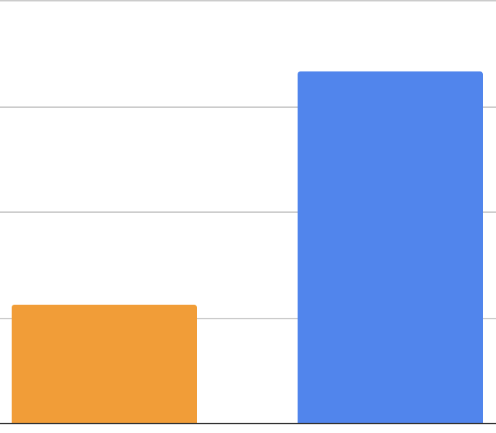
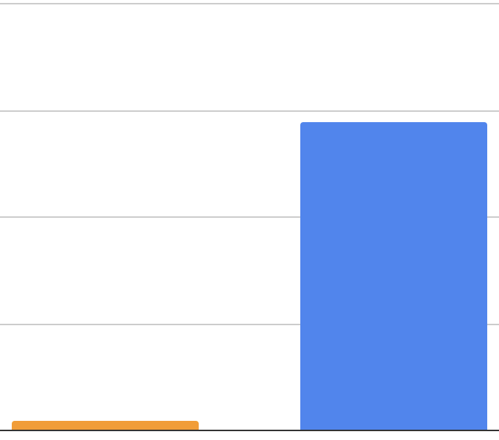
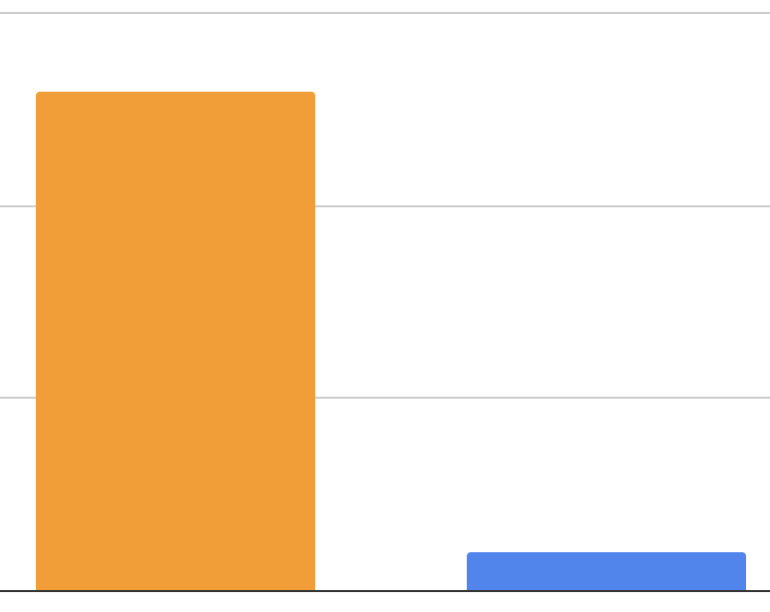

Exploring a New Phenomenon
Slide B
Number of people
Number of vehicles
Ratio of number of people to number of vehicles
333 million
13:1
289.5 million
113 million
9 million
1:1
1921
2021
1921
2021
1921
2021
Our World In Data
NHTSA/Hedges Company
With your class
Orient to the data in the graphs above.
What do you notice?
Notes:
Introduce the first set of graphs and elicit initial noticings. Display slide B. Say, These graphs show us some statistics about the number of people and vehicles in the U.S. over the last hundred years. Give students a moment to read the graphs on the slide. Ask students to share what they notice about the graphs.
Students may share the following ideas:
The number of people has almost tripled over the last 100 years.
The number of vehicles is many times greater (over 30 times greater) now than it was over 100 years ago.
The ratio of people per vehicle has dropped a lot. A hundred years ago, vehicles were pretty rare in comparison to people, but now there is almost one vehicle for every person.

Slide 3
Exploring a New Phenomenon
Slide C
Number of people
Number of vehicles
Ratio of number of people to number of vehicles
333 million
13:1
289.5 million
113 million
9 million
1:1
1921
2021
1921
2021
1921
2021
Our World In Data
NHTSA/Hedges Company
Turn and Talk
Do we think driving has gotten safer over time, or less safe? Why?
For which of the people/places/things that we talked about taking into account?
Notes:
Make predictions about safety trends. Display slide C. Say, After looking at those graphs, do we think driving has gotten safer over time or less safe? Why? And for whom?
Allow students to read the questions on the slide, or read them aloud:
Do we think driving has gotten safer over time, or less safe? Why?
For which people/places/things that we wanted to take into account?
Give students time to discuss these questions with a partner, then have students share out their ideas with the class. Students may share that they think driving has gotten safer, or potentially less safe over time, and that this may apply to everyone or thing identified on the last slide.
Ask students, If we think driving has gotten safer or less safe over time, what things would be making driving safer or less safe?
Document initial ideas. Display the chart paper titled “Things that make driving safer/Things that make driving less safe.” Ask students to share their ideas with the class. Record ideas as they are shared on the chart. For each factor brought up, ask for a show of hands of who else had a similar idea. For each factor that had multiple students considering it, point out that it is interesting that they all shared a similar idea, but don’t take time to write down each factor or a tally at this point.
Students may mention the following for things that make driving safer, or less safe:
Some people drive too fast which is unsafe
People may be more distracted or not paying attention recently which is unsafe.
The number of cars has increased, so there may be more crashes and injuries.
There are more people on the road now than there used to be, so the crowded roads may be less safe.
We may have more people with learner's permits/provisional licenses and such than we did in the past.
Sometimes it can be hard to see or the roads are hazardous, which can affect safety.
Airbags, seatbelts, size of cars, type of car, other car factors may have made driving more safe.
After students have shared some factors, help students pull out the idea that “safer for whom” might include others beyond those in a vehicle. Ask students, Do these factors impact just the driver, or other people? Who else might these factors affect?
These could include things like:
Passengers inside the car
People outside the car (pedestrians, bicyclists, construction workers, other cars)
the environment
animals, plants, etc. that might be in the way of a car
Discuss predictions and how to measure safety. Say, We have been talking about safety, and what factors or things we might have to consider when thinking about safety. But, how exactly would we even measure safety?

Slide 4
Exploring a New Phenomenon
Slide D
Number of people
Number of vehicles
Ratio of number of people to number of vehicles
333 million
13:1
289.5 million
113 million
9 million
1:1
1921
2021
1921
2021
1921
2021
Our World In Data
NHTSA/Hedges Company
With your class
How could we quantify or measure safety?
If your prediction about driving safety over time is true, what pattern(s) would you expect to see in this measure of safety over the past 100 years?
Notes:
Display slide D. Allow students a moment to consider the first question on the slide before sharing their ideas with the class, or have a student read it aloud:
How could we quantify or measure safety?
Look for and highlight ideas about the number of people injured or killed in vehicle collisions.
Then have another student read the second prompt on the slide aloud:
If your prediction about driving safety over time is true, what pattern would we expect to see in this measure of safety over the past 100 years?
Press students to make a connection here between a trend such as “injuries go up” and their predictions from earlier about if driving is more or less safe. Students should say that if driving is safer today than it has been in the past, then the number of injuries and/or deaths would go down over time. If driving is less safe today than it was in the past, then the number of injuries and/or deaths would go up over time.

Slide 5
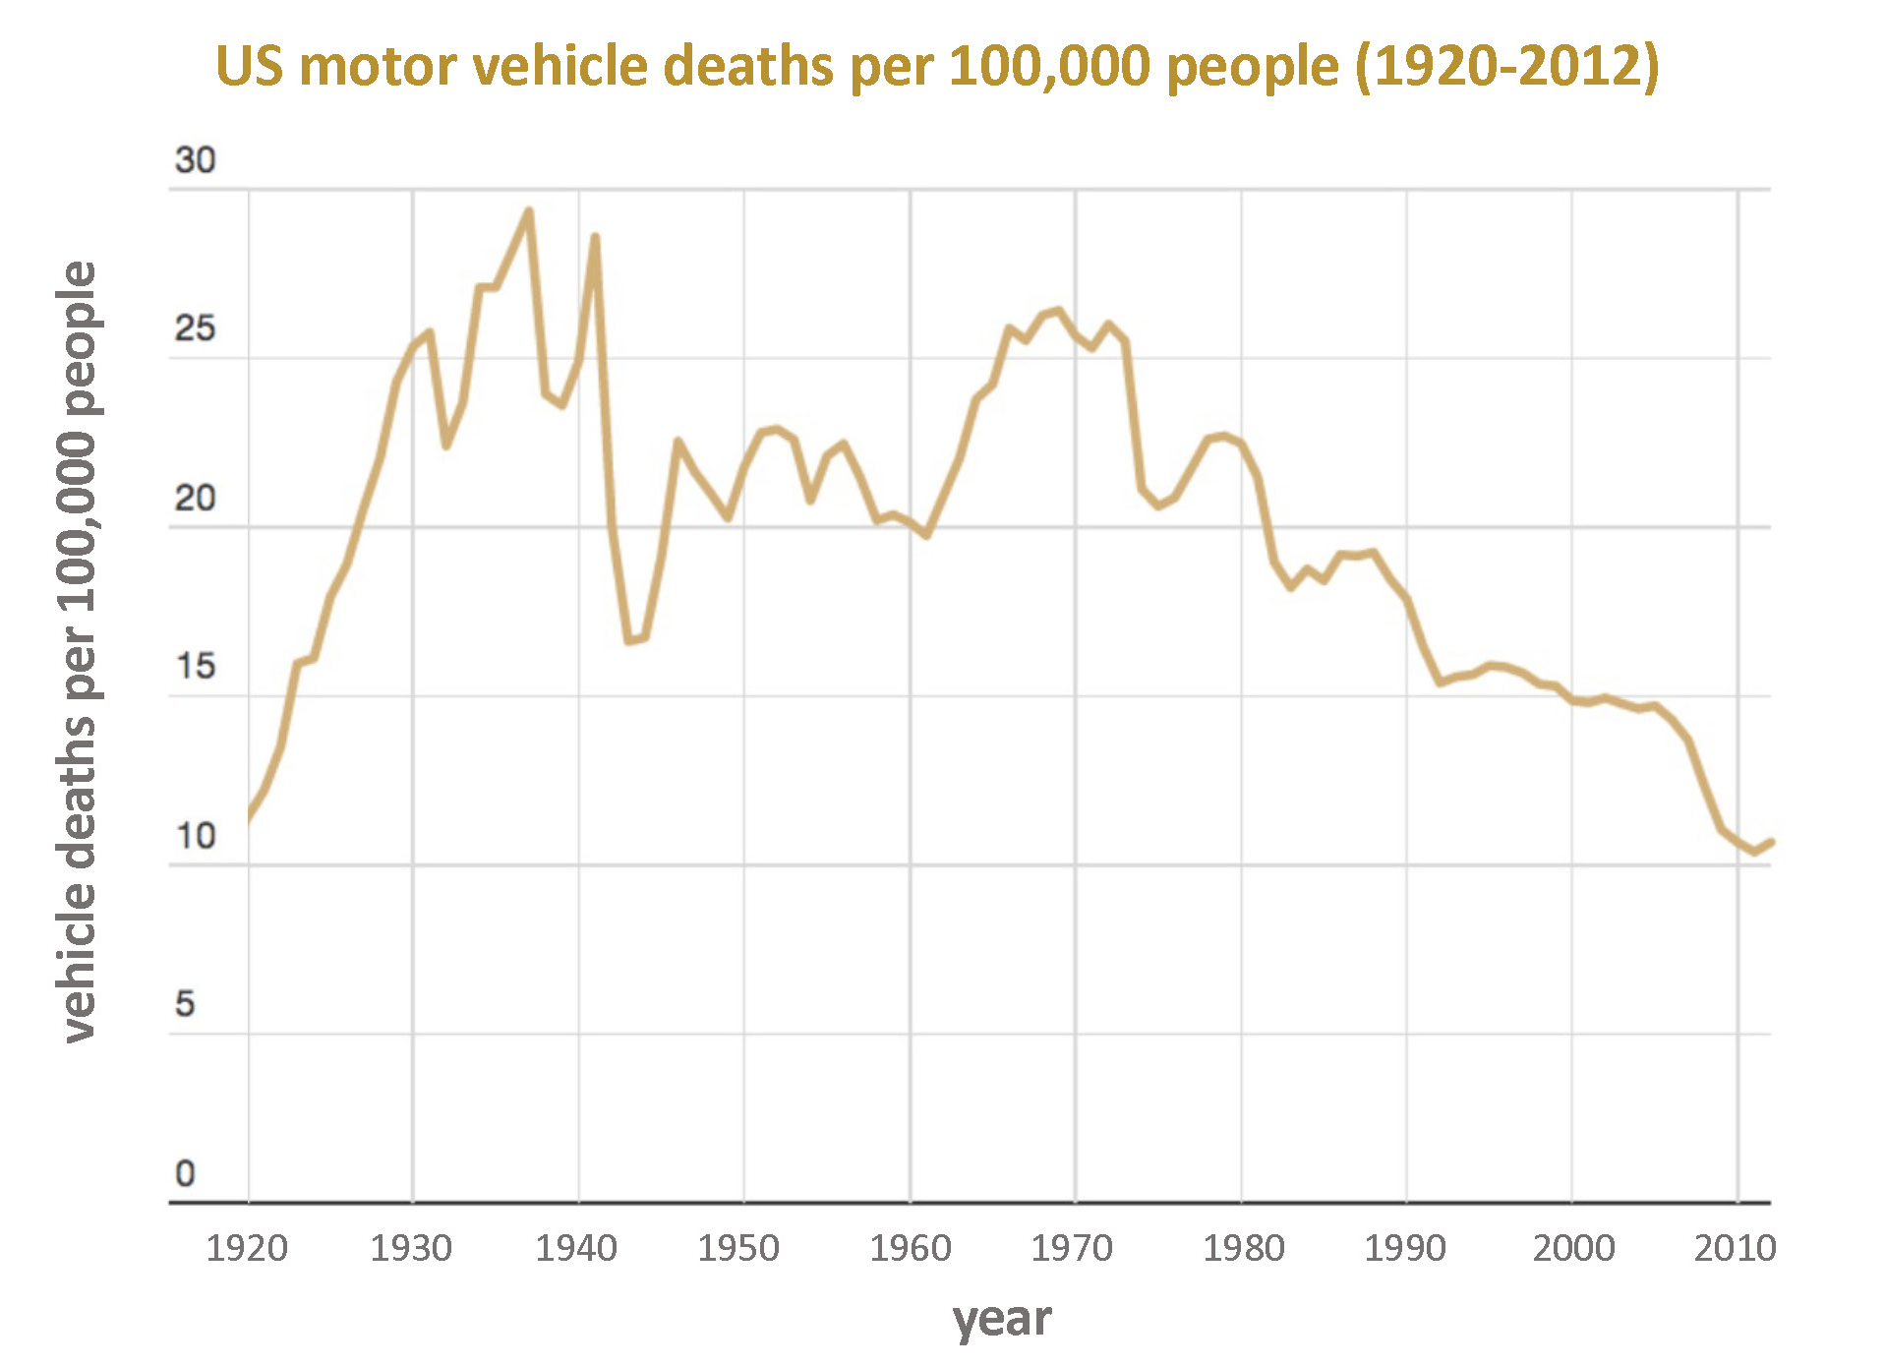
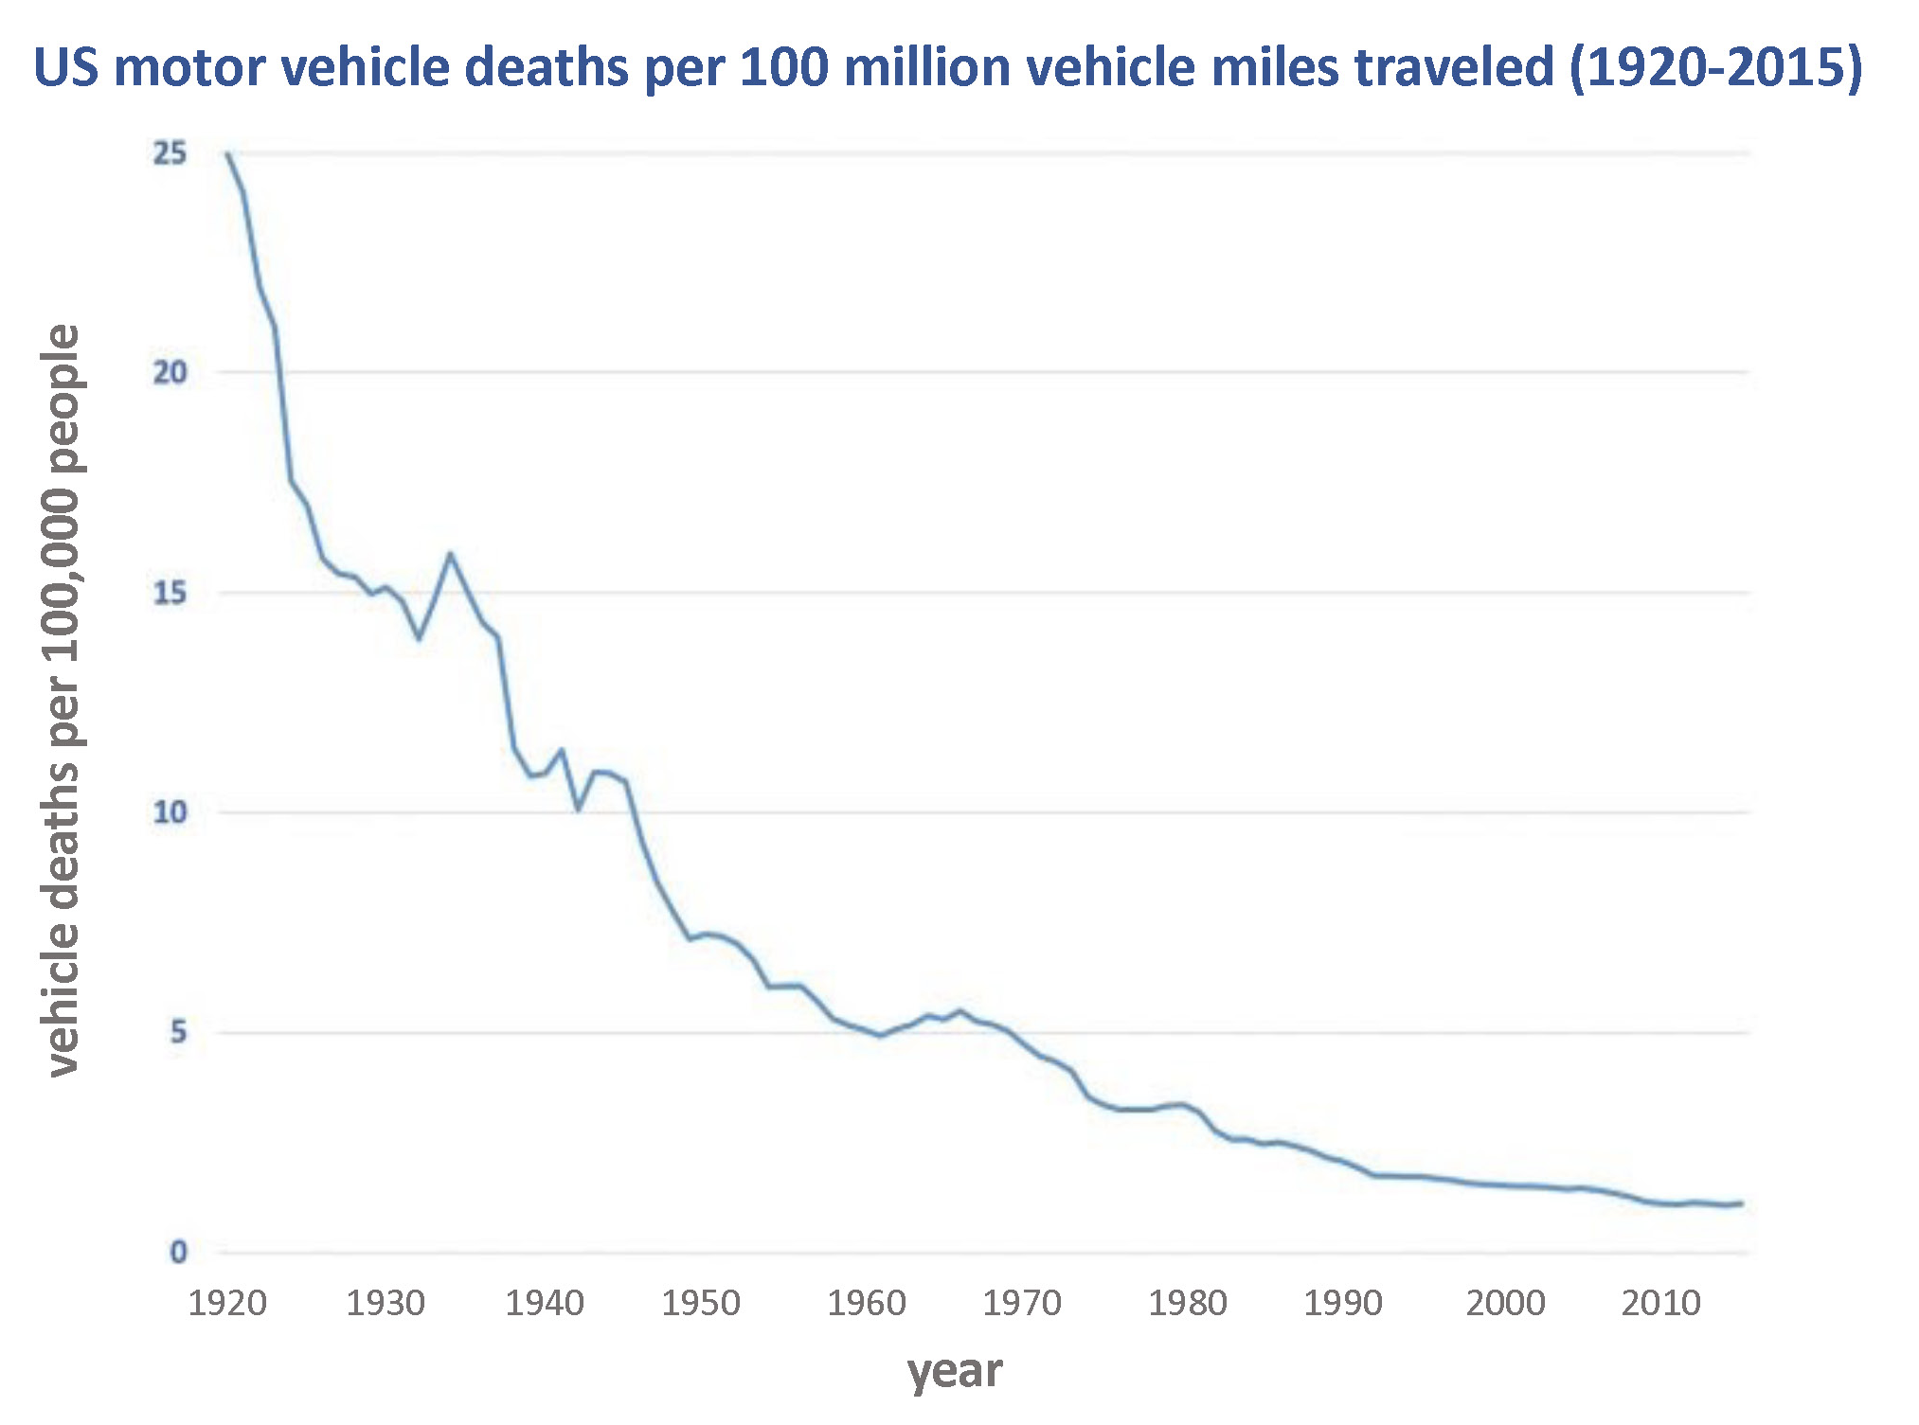
Analyzing Data
Slide E
With your class
What patterns do we notice?
How does this compare to our predictions?
vehicle deaths per million vehicle miles traveled
Notes:
Building Understandings Discussion. After looking at what the graphs show us, focus on the patterns in each graph. Present slide E and read the questions on the slide aloud:
What patterns do we notice?
How does this compare to our predictions?
Students may notice the following patterns:
The number of deaths have generally been going down over time on both graphs.
Deaths per 100,000 people went up from 1920 to the mid 1930s, but then the general trend after that period has been downward.
Even though the “Deaths per 100,000 people '' graph fluctuates some, in general deaths have been going down over the last 90 years.
The 100 million vehicle miles graph decreased quickly at first, but it has leveled out in more recent years (2000s).
Highlight an unclear trend over the past couple of decades. When students mention deaths going down, ask, What about over the past couple of decades, are deaths still going down? Accept all ideas and welcome disagreement, as the next slide will zoom in on the last 30 years.
Say, Let’s zoom into the last part of the 2nd graph and stretch the scale a bit so we can see whether this is a trend that is decreasing in the last 30 years of the graph or if the death rate is relatively flat (constant).

Slide 6
Analyzing Data
Slide F
With your class
What is the trend over the last 30 years?
What do you predict we will see when we look at the number of crashes and injuries over that same period?
3
2
1
0
1990
2000
2010
year
Notes:
Analyze data from the last 30 years. Display Graph F. Say, The pink box is the last part of the 2nd graph we were looking at on the last slide. The section we are zooming into is shown above it.
Ask students what they notice using the first prompt on the slide. Guide students to identify that this graph set also shows a decrease in deaths over time.
Make predictions about crashes and injuries. Using the second prompt on the slide, ask students whether they think we will see similar trends in the number of crashes and injuries over that same period, or if those graphs will look different. Accept all ideas. If there is time, invite 1-2 students to also share their reasoning.
Point out the different metrics we have used so far. Say, Let’s take a look at data on crashes and injuries. Before we do, notice that for fatalities we looked at two different ways to quantify fatalities, one was per 100,00 people and one was per million vehicle miles traveled. So, let’s think about what metrics were used for the next two graphs as well.

Slide 7
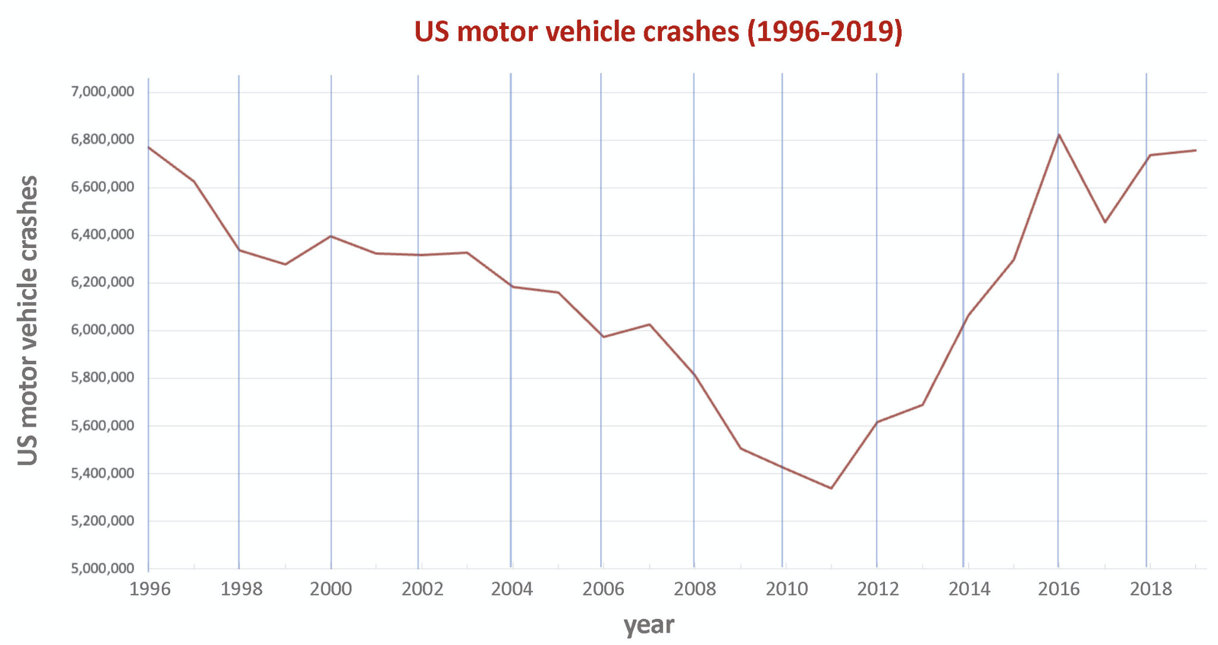
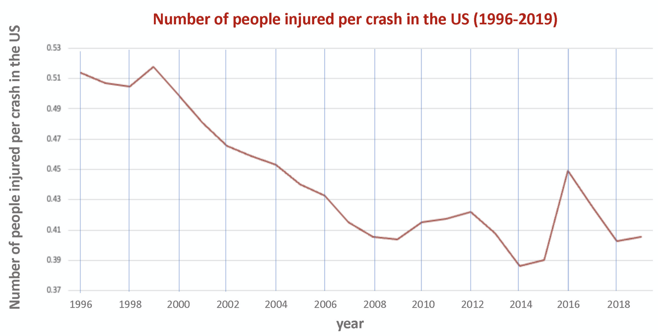
Analyzing Data
Slide G
Turn and Talk
What do we notice?
How does this compare to our predictions?
What do we wonder?
Be ready to share your ideas with the class
Notes:
Analyze Data. Present slide G. Distribute a handout to each partner pair. Give students a moment to turn and talk about the questions on the slide:
What do we notice?
How does this compare to our predictions?
What do we wonder?
Begin a whole group share-out by asking about differences students notice between measurements used on each graph. Listen for students to say that the y-axis measure is different. The top graph shows the total number of crashes, while the bottom graph shows the number of people injured per crash.
Discuss the y-axis range for the second graph. Ask students what it means for there to be 0.5 people injured per crash. Listen for ideas about this being a ratio or a percentage, such as:
50 injuries per 100 crashes
50% of the people in a crash get injured
1 person injured every 2 crashes
Have 2-3 students share out how this data compares to the predictions they had made after viewing the last slide. As students share their predictions and how this graph either matches or does not match their predictions, ask them to point to what in the data had led them to that conclusion.
Identify trend lines individually. Point out that students seem to be referencing specific sections of the graphs, and that the graph shows several trends, as they have mentioned. Ask students to look at the data and draw any trend lines they see on the handout. Suggest that they use a different color to label each trend that they see.
Mark key trends lines on chart paper. After students have drawn trend lines on their own, ask students about what trends we see in these two different measures over time. Add the blank chart paper pieces under the projected image of the graph. As students share these trends, draw the trend line that is being identified on the dataset. Students should identify at least two trends in the first graph, and at least one trend in the second:
Top graph:
decrease in first part, (1996-2009)
an uptick in the second part (2009 onward)
(Optional) some leveling off in recent years (2016-2019)
Bottom shows:
decrease in first part, (1996-2009) and some fluctuation and leveling off (2009 onward) OR
a general decrease over the entire period with some more fluctuation toward the end.
As students share, ask them to come up to the chart and draw the trend line that they have identified. For each new trend line, make sure to have the student use a new color. Use letters (A, B, C, etc…) to label each of the trend lines on each graph after students have identified a section. The example shown here shows each graph broken up into two to three possible trend lines each.

Slide 8

Developing Initial Explanations
Slide H
With your group
Assign each person a different trend (A, B, etc) to record possible causes for that trend that the group discusses. Each person will need to:
Prepare a piece of notebook paper with the related letter for that trend.
Record what is discussed so that it can be read from across the room (e.g. with a thick marker).
Causes for trend A
-----------
-----------
-----------
Causes for trend C
-----------
-----------
-----------
Causes for trend B
-----------
-----------
-----------
Causes for trend D
-----------
-----------
-----------
Be ready to share your ideas with the class
Notes:
Developing initial explanations. Show slide H. Review the directions on the slide and group students based on the number of trend lines you have identified as a class (e.g. 5 trend lines would mean groups of 5). Emphasize to students that the goal is for every group to have something that can be held up and be read by everyone in the room for each trend line. Distribute markers and whiteboards to each student.
Ask groups to assign each group member a trend line amongst themselves. Give small groups 5 minutes to record their ideas. If students finish their trend line early, suggest that they help out their fellow group members with their assigned trend line.

Slide 9
Developing Initial Explanations
Slide I
With your class
For each trend in the data:
Have the assigned group member share the causes they listed with the rest of the class by holding up their whiteboard
Do this for each group, and record new ideas next to each trend we identified on the chart paper
Notes:
Share possible causes for trends with the class. Display slide I. Ask all students to turn their chairs towards the center of the room. Beginning with trend A, ask those who identified potential causes for trend A to hold up their possible cause list. Give the class a moment to read the charts and ask students to share out any potential causes that make sense to them, or are mentioned across multiple groups. As students are sharing out, write these causes around the part of the trend line that they are discussing. Give roughly 90 seconds for each trend.
Draw out ideas about distracted driving. As students share out, make sure that one possible cause that emerges across the trend lines of increased crashes and injuries is related to distracted driving. If it doesn’t come up naturally, you can ask students to consider changes in technology over the past few decades that might have led to this increase. If students don’t come up with cellphones or other distractions quickly, do not play guess-what’s-in-my-head. Say, I wonder if people are more distracted now than they were before. Could this have an impact on the data?
Tell students that we will develop some initial models about the role of each of these possible causes. Suggest that we start with distracted driving, because we all agree it could have an impact.

Slide 10

Developing Initial Explanations
Slide J
On your own
In your notebook record your initial claim for each of these questions:
Could distracted driving affect the severity of a collision?
Could distracted driving contribute to an increase in crashes?
Be ready to share your initial claims with your partner
Notes:
Develop Initial Claims. Display slide J. Give students 4 minutes to record an initial claim for each question. Have students compare these claims with their partner.
Poll students about distracted driving. Take a quick poll (show of hands) before students leave regarding whether their partner pair was in agreement on both questions. Suggest that to develop a model next time to identify areas of agreement and disagreement related to these initial claims.

Slide 11

Develop an Initial Model
Slide K
With a partner
Enact different collision scenarios for both distracted and non-distracted drivers to try to explain the following:
Does the type of crash affect the outcome?
What parts of the system and changes to those parts are contributing to the severity of the crash in each scenario?
Could anything, other than distracted driving, affect the outcome of the collision?
In your notebook, record any changes you identify in the two-car system that could impact the severity of the crash.
Notes:
Make sense of the data. Display slide K. Say, Yesterday we developed claims about whether distracted driving had an impact on the outcome in a collision and the trends we saw on our graphs related to an increase in crashes in recent years. Let’s get back with our partners today and see if we can use slips of paper as manipulatives to explain our thinking and understand what might be happening in the system to either support or refute your claims.
Distribute two toy cars to each partner pair. Ask students to work with a partner to show different possible collision scenarios, distracted vs. non distracted driving, and how those scenarios might impact the trends we have identified on our graphs over time. As students work, direct them to record any observations or ideas that they have that can help either support or refute their initial claims in their notebooks.
Circulate as students enact different collision scenarios. Ask students to model a crash in a distracted scenario and then a non-distracted scenario. For each possibility have students enact the position, direction and motion of the vehicles that would result in a collision if the drivers are not distracted. Then rewind the motion of the vehicles to the initial point the students started their vehicles at. After students have played out the non-distracted scenario, ask them to play out a distracted scenario. Encourage students to show different types of crashes and scenarios. As students are enacting these various scenarios, ask students the following questions:
What differences, if any, do you see between the behavior of the vehicle and person in the first versus second scenario?
Does the type of crash affect the outcome?
What parts of the system are contributing to the severity of the crash? What changes in the two-car system might lead to the increase in crashes trend we saw in our graphs?
Could anything, other than distracted driving, affect the outcome of the collision?
As students are working on this, place the 4 pieces of regular paper with the four cases listed below so that it is visible by all students. Set 2 slips of paper representing cars up in a position and orientation that would capture the state of the system a second or so before a collision for each of these cases:
Case 1: Perpendicular collision (or T-bone) (e.g. One vehicle pulling out in front or driving across the path of another one from a side street or cross-traffic)
Case 2: Side against side collision (e.g.Two vehicles traveling toward each other in different lanes of traffic and one crosses over into the other’s line of traffic and they collide against their sides )
Case 3: Head-on collision
Case 4: Rear-end collision (e.g., two vehicles driving in the same direction. The car in front slows down or stops, and the driver behind hits it. OR, you slow/stop your car, and the vehicle behind runs into your vehicle)

Slide 12
Develop an Initial Consensus Model
Slide L
With your class
Develop a class consensus model to help explain how a distracted driver vs. a non-distracted driver would affect the outcome of a collision for each of the cases.
Notes:
Develop an Initial Class Consensus Model and Explanations. Display slide L. Bring students together in a Scientists Circle. Direct students' attention to the 4 cases that you set up. Say, To get us started on developing a consensus model I set up 4 common collision types I saw being discussed by different groups. Did I miss any?
Give a half minute to consider the 4 cases. Ask students if there are any additional cases we need to add to represent that are not represented already. If any new cases are suggested and the class agrees that the 4 already made ones don’t capture that 5th or 6th case, then make another setup using two more cars, and a piece of paper to label the setup. Move on to capturing ideas that students discussed on a poster paper. Guide students to consider what factors might influence the severity of the crash, starting with what happens before the collision first.
Say, We not only played out the scenarios with the crash, but as I was walking around I noticed that you were also making changes to the cars before the crash. What changes were you making before the crash that were different between distracted versus non-distracted conditions in the system that might help explain why we have different outcomes?
Begin a consensus discussion by focusing on what is happening before the collision on Chart 1. Lead a discussion to determine that factors such as speed or distracted driving and distance from impact could play a role in the severity of a collision. As students share, add their ideas to the first chart titled, What is happening in all these cases BEFORE the collisions that would help explain these different outcomes. Example prompts and responses are below. See the prompts in the teacher guide for support.
When students start to discuss time, push students to explain what distances or times the class is referring to, if they are referring to distance to a fixed point in space, or a distance to between the vehicles. Determine if the class is also referring to time at which something starts happening or the duration (length of time) something happens. Record any ideas that come up on the first chart titled, What is happening in all these cases before the collision, that would help explain these different outcomes. Most students are likely to have competing ideas regarding frame of reference, so mark these with question marks.
Shift to the bottom prompt on the same chart, asking about what is actually happening during the collision that may cause different outcomes at the point in time at which first contact is made in the system, beyond just saying differences in speed. Students are likely to bring up speed, vehicle differences such as weight, and angle. Record any ideas students may have on the bottom of the chart under the header, What is happening AT the point in time at which first contact is made in the collision to CAUSE the different outcomes.
Move to Chart 2 (Impact on the Vehicle). Say, It seems that we all think there are factors that might affect the outcome of the collision that come into play before the collision even occurs, but we also think that distracted driving might have something to do with this. What might be different in a collision with a distracted driver vs. a non-distracted driver collision?
Lead a discussion to determine these differences and record them on the second piece of chart paper. Students are likely to focus and talk about what they will see differently from the more distracted perspective (more damage, etc.) and this is fine. Ask students to clarify the differences in distracted and non-distracted if they only mention more severe or outcomes of only one condition. Document the differences in each example and ask students if one car would be damaged more than the other. Example prompts and responses are below. See the prompts in the teacher guide for support.
Say, Now that we have thought about the outcomes of the vehicle, let’s think about the occupants.
Remind students that the number of deaths is still steadily decreasing over time, but the number of crashes has increased, and our number of injuries has also moderately increased. Ask students to speculate about what differences in injuries we might see in a distracted versus non-distracted collision, and what might cause those differences. Record these ideas under a new heading or on a separate chart titled, How would the outcome for the people in both vehicles compare? Example prompts and responses are below. See the prompts in the teacher guide for support.
Emphasize that this feels like a set of additional things we should be trying to explain could be affecting the outcome of the collision and suggest we revisit the list of these factors/features in the system we generated earlier and add to these.

Slide 13
Navigate: Raising New Questions
Slide M
We have developed our first consensus model to try to explain the effects of distracted driving on the outcome collision.
Write one question per sticky note.
Write in marker--big and bold.
Put your initials on the back in pencil.
Place your sticky note next to the part of the chart that most applies to your question.
On your own
What new question does this model raise for you?
Notes:
Develop initial questions for the DQB. Display slide M. Read the text at the top of the slide. Point students to the Distracted Driving Initial Consensus Model charts and then say, On a sticky note, record any new questions this model raised for you. Record only one question per sticky please, and don’t forget to add your initials so that we know who contributed a question when we share out later.
Instruct students to place their sticky note next to any phrase on the three charts that most applies to their question. Tell students that we will come back to these questions next class period.

Slide 14
Navigate: Brainstorm Additional Factors
Slide N
Even though crashes have increased in more recent years, injuries and deaths of people in the vehicle have decreased.
With your class
Are there any other important factors we should add to our list that we think are responsible for the trend we see in decrease in deaths and injuries of people in the vehicle in recent years, in spite an increase in crashes regardless if the driver is distracted or not?
Make a public record of these
Notes:
Revisit (and add to) a list of other factors. Display slide N. Refer students to the factors the class had listed on the Trends chart and ask students which of these factors we have worked to explain. Students will say distracted driving. Suggest that now that we have captured a record of our ideas about how distracted might affect the outcome of the collision, we should also try to explain how some other factors might affect the outcome as well.
Emphasize the trends described at the top of slide N: We know that crashes have increased in more recent years, BUT injuries and deaths of people in the vehicle have decreased. Suggest that we develop two different lists of possible factors that could contribute to each part of this trend.
Ask students to revisit the Distracted Driving Initial Consensus Model charts. Record any additional suggestion of important factors that should be added to the list to explain this trend that they may have come up with since the last time the chart was created. Record any additional ideas students share for each.
Ask students to identify which of these factors are different from distracted driving, in that, they influence the outcome of the collision, but are mostly independent of how people are interacting to and/or responding to what is happening around them. Put a checkmark next to each of these. These will tend to include the physical attributes and structures in the system such as:
Size or weight of the vehicle(s)
The type of road or road conditions
Angle of impact
Age of vehicle
Seatbelts
Airbags
Lane assist, automatic emergency braking, or another adaptive technology
Materials the vehicle is made of (e.g. Plastic vs. metal)
Shape of the vehicle or type of vehicle (truck vs. car)
Develop an Initial Model. Point out that the list we developed identified possible variables that could cause these increased injury outcomes, and that the check marks indicate some factors or features that are related to a physical attribute or structure of something in the system. Emphasize that to understand all of the trends in the data, as well as start considering ways to make design safer vehicle transportation systems, we will need to consider some of these checked factors or features beyond just simply saying they may be a possible cause. We need to try to understand how or why any one of those variables would cause a decrease in deaths and injuries of people in the vehicle in recent years, even though the number of crashes has increased.

Slide 15
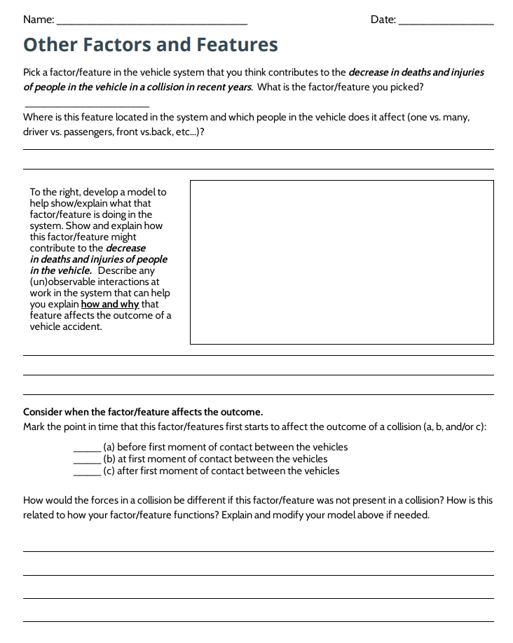
Develop an Initial Model
Slide O
On your own
Develop a model to help explain how/why different factors (beyond distracted driving) would contribute to a decrease in deaths and injuries of people in the vehicle in recent years.
Be ready to share your ideas with the class.
Notes:
Show slide O. Distribute handout and ask students to select one of the checked variables on the list that they want to try to explain. Tell students that we want to explain how or why that factor or variable would contribute to this trend in the data we saw (a decrease in deaths and injuries of people in the vehicle in recent years).
Before allowing students to begin, take a quick poll of how many students are picking a given factor. If you find nearly all students are picking just two factors (e.g. seat belts and airbags), ask for some volunteers who’d be willing to try explaining a different factor to ensure a wide range of explanatory ideas.
In preparation for the home learning assignment, take a high resolution photograph of the first consensus model chart. Be prepared to share the image with students at the end of the day.

Slide 16

Develop an Initial Consensus Model
Slide P
With your class
Develop a record of what we agree and where we have competing ideas for different factors that start affecting the outcome of the collision at different points in time.
What (un)observable interactions at work in the system are similar? Which are different?
Notes:
Create the Factors and Features Initial Consensus Model. Display slide P. Gather in a Scientists Circle to develop a record of what we agree on and where we have competing ideas for different factors that start affecting the outcome of the collision at different points in time. Ask students to bring their copy of handout.
Say, We have a lot of factors and features represented by our class, but do they all work the same way and at the same time?
Students should answer that they do not work the same way or at the same time. Ask students to explain when these factors and features might have an impact on the collision. Students should say that some features work before the collision, like wheels and braking, and others work during the collision, like the frame of the car or seatbelts. Draw on the chart paper the time series in question. Break up the time series into 3 moments: before the collision, the moment that the objects make contact, and during the collision.
Share and record factors and features and effects of those factors and features. Add a poster to the left or right of the time series poster. Ask students to share a factor or feature that they have modeled. For example, students may mention airbags. Draw a diagram of this feature in a space around the time series and ask students to explain how this feature works. Allow students to explain their ideas and record student ideas around this feature. Press students to explain what this feature does to reduce the number of injuries and how this affects forces in a collision. As students present their ideas, list them around the item being modeled. Put a question mark next to ideas that the class is not in consensus about, and stars or exclamation points next to ideas we can all agree upon. Ask students to then explain when this factor/feature begins to affect the outcome of the collision, at timepoint 1, 2, or 3. Accept student responses and label the item being drawn with 1, 2, or 3.
Apply the factor to the time series. Move to the representation of timepoints 1, 2, and 3 on the first poster. Ask students to explain during which windows of time the factor or feature would affect the outcome of the collision. Draw a bracket under the moments in time that students believe applies to that factor or feature and label it with the name of the factor or feature. If students do not agree on a section of the time series, do not bracket that area. Instead use a dotted line to represent this area as an area of question amongst the class.
Add more factors and features to the model. After applying the first item to the timeseries, move on to another factor or feature. Repeat this process until all factors and features are present on the model. Below is a list of factors and features that students may mention, organized by where students may believe they impact the outcome of the collision.
In time series A, before the first moment of contact between the vehicles.
Brakes
Wheel size / conditions
Road conditions
Automatic braking
Seatbelts (potentially)
In time series B, at the first moment of contact between the vehicles
What the vehicle(s) are made of
The size/mass of the vehicle
The angle /point of contact between the vehicles
Air bags
Seatbelts
In time series C, after the first moment of contact between the vehicles
Air bags
Seatbelts
What the rest of the inside of the vehicle is made of (steering wheel, dashboard, seats in back)
After all factors and features have been shared, take a moment to look back at the models. Ask students what seems similar and what seems different about the factors and features we have modeled. Allow students to quickly share out their ideas, and accept all responses. Explain that tomorrow we will continue to think about what might be contributing to the increase in crashes and injuries, and what additional questions they may have.

Slide 17

Develop an Initial Consensus Model
Slide Q
With a partner
Review your individual model from last class with a partner.
What is similar and different between your models and the class consensus model?
Notes:
Review the consensus model. Display slide Q. Give students a moment to reflect on the Factors and Features Initial Consensus Model from last class, and discuss with a partner what they find similar or different in their [material:PM.L1.HO3] and the second initial consensus model. This will help students re-familiarize themselves with the model. If you are ahead of schedule and this step is done on the same day that the second consensus model is built, skip the slide R instructions and proceed on to slide S.

Slide 18
Build the DQB
Slide R
We have developed two consensus models: one for the effects of distracted driving on the outcome of a collision, and another for the effects of other factors/features.
On your own
Write one question per sticky note.
Write in marker--big and bold.
Put your initials on the back in pencil.
Write down at least one question that you have about these other factors/features.
Notes:
Bring the class back together and display slide R. Remind students that over the past two days, the class has worked together to create two initial consensus models. Both of these models represent what we think might be contributing to the trends that we see on our graphs showing crashes and injuries over time. Remind students that we have also encountered questions as the models were constructed. Now students will get the opportunity to consider their questions again.
Read the text at the top of the slide and direct students to write at least one question they have on a sticky note. Point out that each sticky note should contain only one question, and students need to write their initials on the back of the sticky note. Tell students that it is okay if most of their new questions relate to the Factors and Features Initial Consensus Model, since questions related to distracted versus non-distracted driving may have been posted earlier on the Distracted Driving Initial Consensus Model. Also let students know that it is okay to add any new questions they also have about distracted driving at this time. Remind students that the DQB will grow over the course of the unit, and that when the class thinks about new ideas or looks at data in a new way there will naturally be more questions that will emerge in that process

Slide 19
Build the DQB
Slide S
With your class, gather around the DQB.
Choose a volunteer to go first. This student reads their question and then sticks it onto the DQB.
Raise your hand if you have a question that is similar or the same. The first person calls on the next person, who reads their question, says how it relates, and then sticks it onto the DQB near the first sticky.
Repeat Step 2 until all similar questions in the room are stuck to the board.
Another student reads a new, unrelated question. Continue until everyone has at least one sticky on the DQB.
Notes:
Support students in building out the rest of the DQB. Present slide S. Arrange students in a scientists circle with the two consensus models positioned so that all students have easy access to the models. Tell students, Let’s use the two initial consensus models that we have made to organize our new questions. We can place questions related to the models on top of the parts that they are associated with on the poster, and then cluster related questions nearby.
Explain to students that they will take the lead on this process. Choose the first volunteer to begin the process and then allow students to follow the process outlined on slide T. Step in when necessary to point students to some of the class’ norms to encourage equitable participation. The student-facing directions for assembling the DQB printed on the slide and the handout are:
Choose a volunteer to go first, read their question, and put it on the DQB near the part of the system to which it is related.
Raise your hand if you have a question that is related or the same.
The first volunteer selects the next student whose hand is raised. The student who is called on reads the related question, says why or how it relates, and then moves it onto the DQB with the original question.
That student selects the next student who will read another related sticky note and move it, and then call on the next student.
Continue until the class agrees that all the related questions have been placed, and that they are located in the right place on the consensus model. Then go back to step 1, and choose a volunteer with a different question to start a new cluster. Continue until everyone has shared at least one question.
Allow students to share their questions and moderate the process until all questions have been posted on the consensus models that make up our DQB.
Brainstorm related phenomena. Say, We have been thinking primarily about collisions between two cars to this point. Are regular cars all that we have on the road, and do regular 4-door sedans only ever collide with other 4-door sedans?

Slide 20
Related Phenomena
Slide T
Turn and Talk
What are some other types of vehicle collisions that we should learn more about?
What else could a cars collide with that we should investigate to improve everyone’s safety?
Be ready to share your ideas with the class, and add new questions to the DQB
Notes:
Use slide T to prompt students to turn and talk about the following:
What are some other types of vehicle collisions that we should learn more about?
What else could a cars collide with that we should investigate to improve everyone’s safety?
After 2 minutes, bring students together to share out their ideas. Keep a public record of students’ suggestions in response to the second question at the front of the room. Title the list: “Related Phenomena.” You can do this on chart paper, a white board, a projected document, or a transparency. You may hear ideas such as:
Cars colliding with walls
Larger vehicles colliding with smaller vehicles
Collisions between vehicles and wildlife
Collisions between vehicles and pedestrians or bicyclists
After this, ask students if they have any more questions that they would like to add to the DQB. Allow students to read the questions and quickly add any questions they have to relevant areas of the DQB.
Say, There are a lot of collisions we feel that we need to learn more about to improve the safety of those humans and other living things involved. If we think back to our trend lines, it seems like we can connect some of these ideas, and ideas from our models, that might help explain these trends. Let’s think about that now.

Slide 21
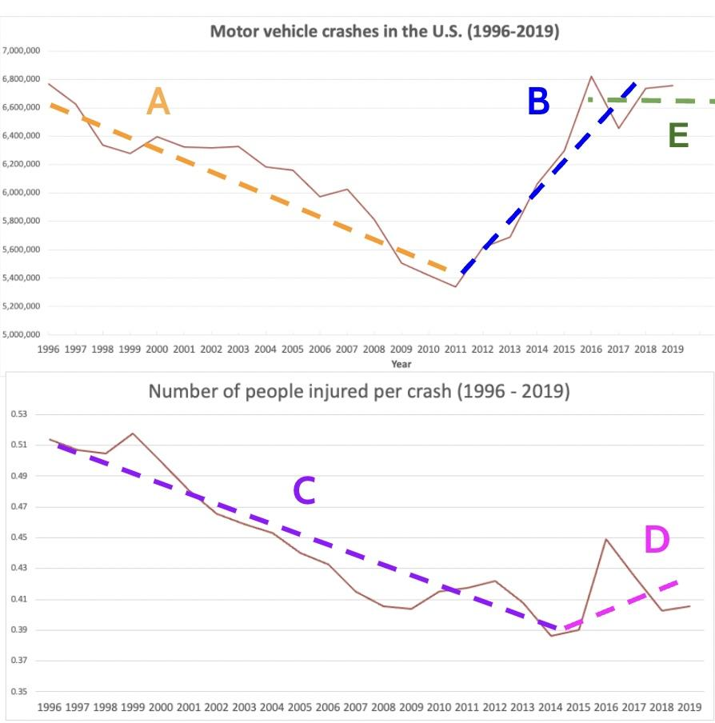
Comparing Models to our Graphs
Slide U
Turn and Talk
How do our models explain our trend lines?
Replace this image with an image of your class’ trend graphs
Notes:
Compare models to trend lines. Use slide U to prompt students to turn and talk about the following: How do our models explain our trend lines? Remember that this is an initial ideas discussion designed to surface student ideas for investigations, and do not expect strong connections right now between science ideas and trends in the data.
After 2 minutes, bring students together to share out their ideas. Direct students to look back at the graphs on which we had drawn trend lines and labeled potential causes. Guide students to point out that the first models the class developed might apply to the areas we have flagged for distracted driving, while our new model applies to the decreases in crashes and injuries.
Point out that in order to explain these trends and to understand why driving has become less injurious over time even though crashes have increased, we will have to investigate the questions we have developed over both models.

Slide 22

Ideas for Future Investigations
Slide V
With your group
Ideas for Future Investigations and Data We Need
Look at our question clusters.
Topic Cluster #1
Topic Cluster #2
What data or investigations might we need to help answer our clusters and inform possible design solutions?
Record these on a strip of paper. Be ready to add them to our class chart under the cluster title.
Idea #1
Idea #1
Idea #2
Idea #2
Idea #3
Idea #3
Be ready to share your ideas with the class
Notes:
Ideas for investigation. Display slide V. Ask students to get into small groups and review the clusters. Clusters may have emerged by either poster or sections of posters. Mark these sections clearly for students. Have students consider each question cluster and try to develop an idea for investigation centered around that clustering. Assign different groups to start with a different topic cluster.
When students have determined an idea for investigation, ask students to write their idea down on a strip of paper. Emphasize that their group can then stick their strip of paper to the chart you are going to create and come up with a second idea, or they can move on to a new topic cluster.
As students develop questions, display the Ideas for Investigations and Data we Might Need chart. Quickly write each cluster title with an area under each cluster title for students to add strips of paper. Make sure that tape is handy for students to easily post their ideas to the chart.
Give students 6 minutes to record their new questions on paper strips and add to the corresponding topic cluster on the chart. At the end of this time all student groups will have needed to add their strips of paper to the Ideas for Future Investigations and Data we Might Need chart.
After the questions have been generated and posted, review each cluster with students for common ideas for investigations or data requests. Anticipated responses are below:
Reaction time, distance, and vehicle speed measurements.
Video or photos of collision
Collision statistics data by vehicle type
Crash dummy measurements (motion, forces, damage)
Testing various vehicle collision conditions ourselves in a scaled down system (e.g. two vehicles on a track, with different speeds, masses)
Testing different type of vehicle materials ourselves and the effect on the collision in a scaled down system (e.g. metal, plastic, other)
Testing the effects of adding seat belts, airbags, etc… on the damage to a simulated passenger in the vehicle (e.g. an egg, a clay ball, etc…)
Use a computer simulation to test the effects of different design solutions (seatbelts, airbags, etc…) on the people and the vehicle.
Say, It seems like we have a lot of ideas for investigation and have identified data that we need. Let’s look back at our two charts and consider where to start.
Ask students to consider what area we seemed to think contributed the most to our trends in data that we should investigate first. Students should identify that they think the trends identified in the graphs were related to distracted driving. If students do not directly go to distracted driving, revisit the list of potential causes under each segment of the graph and remind students that their first set of ideas focused around the impact of distracted drivers on the data. Explain that since the class believes that this is the most likely potential cause of the increase in crashes, we will start there next class.

